Slide 1
Introduction
Dr. B C Dhara
Department of Information Technology
Jadavpur University

Slide 2
Books
Cryptography Theory and Practice by Stinson
Handbook of Applied Cryptography by Menezes, Oorschot, Vanstone
Forouzan, Cryptography & Network Security, Tata McGraw-Hill
B C Dhara, Dept. of IT, JU

Slide 3
SECURITY GOALS
We are living in information age
Information is grate assets, it needs to be secured from attacks
  To be secured, information needs to be
    Hidden from unauthorized access (confidentiality)
    Protected from unauthorized changed (integrity)
    Available to an authorized person when needed (availability)
B C Dhara, Dept. of IT, JU

Slide 4
SECURITY GOALS (Contd…)
Previously, information of an organization was stored in a physical file
  Confidentiality was achieved by restricting the access to a few authorized and trusted people
  Few authorized people are allowed to change the contents of the files
  Availability was achieved by designating at least one person who would have access to the files at all times
B C Dhara, Dept. of IT, JU

Slide 5
SECURITY GOALS (Contd…)
At the computer age, information become digital and stored in computer
Files stored in computer also required confidentiality, integrity and availability
  Implementation of these are different and challenging
B C Dhara, Dept. of IT, JU

Slide 6
SECURITY GOALS (Contd…)
Computer networks created revolution in the use of information
  Information is now distributed
  People can send and retrieved information from a distance through computer network
    Above three requirements have not changed
      Now they have new dimension
      Not only it has to be maintained the security when stored in computer, also have to be maintain the security when transmitted from computer to computer
B C Dhara, Dept. of IT, JU

Slide 7
SECURITY GOALS (Contd…)
We will study
  three major goals of information security
  Attacks on these goals
  Define security services and how they are related to the three security goals
  Security mechanisms to provide security services
  Techniques,
    Cryptography, Secret sharing, watermarking and steganography, to implement security mechanisms
B C Dhara, Dept. of IT, JU

Slide 8
Possible solutions
  Cryptography
    Cryptography is about protecting the content of messages
    Scramble message to make it meaningless
  Hiding
    Steganography is about concealing the existence of messages
    Hide the existence of communication
  Watermarking
    Watermarking is about establishing identity of information to prevent unauthorized use by hiding a message about the media
  Secret sharing
    Divide the secret into pieces, distributed to participants and authorized subset of participants can recomputed the secret

Slide 9
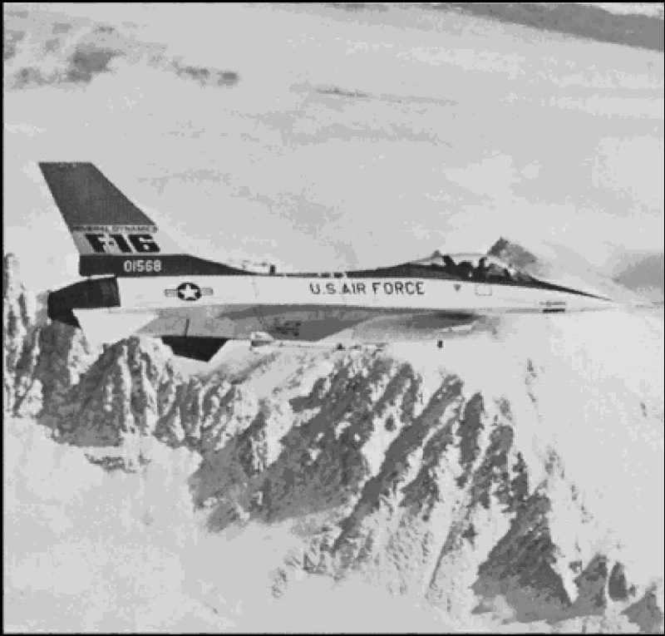

Example cryptography
Key
Algorithm

Slide 10



Data hiding (Steganography)
Secret message
Cover Image
Stego Image

Slide 11



Watermarking
Watermark image
Original image
Watermarked image

Slide 12





Secret sharing
Sharing algorithm
Reconstruction algorithm
Select any 3 shares out of 4

Slide 13
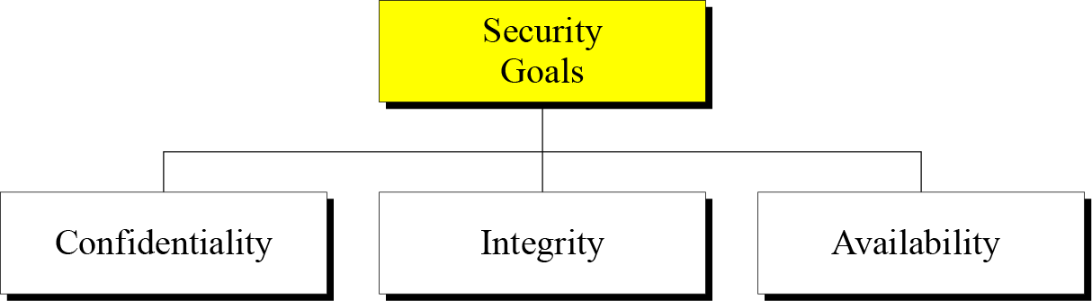
SECURITY GOALS (Contd…)
Taxonomy of security goals
B C Dhara, Dept. of IT, JU

Slide 14
Confidentiality
Confidentiality is probably the most common aspect of information security. We need to protect our confidential information
  An organization needs to guard against those malicious actions that endanger the confidentiality of its information
    In military, concealment of sensitive information is major concern
    In industry, hiding information from competitors is crucial
    We need to conceal information during transmission
B C Dhara, Dept. of IT, JU

Slide 15
Integrity
Information needs to be changed constantly
Integrity means that changes need to be done only by authorized entities and through authorized mechanisms
  Integrity violation not necessary a malicious act
    Due to power failure, at the time of updation, unwanted changes in some information
B C Dhara, Dept. of IT, JU

Slide 16
Availability
The information created and stored by an organization needs to be available to authorized entities
  Information is useless if it is not available
Information needs to be constantly changed, which means it must be accessible to authorized entities
B C Dhara, Dept. of IT, JU

Slide 17
Attacks
The three goals of security⎯confidentiality, integrity, and availability⎯can be threatened by security attacks
Attacks divided into three groups related to the security goals:
  Threatening Confidentiality
  Threatening Integrity
  Threatening Availability
B C Dhara, Dept. of IT, JU

Slide 18
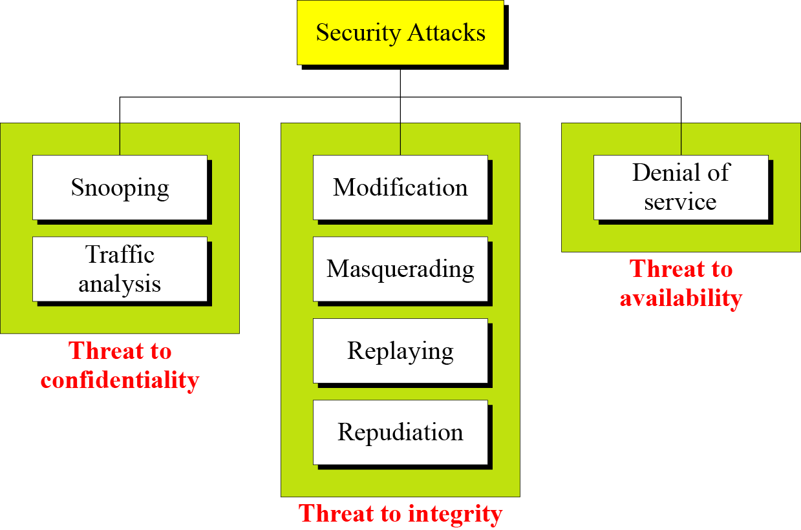

Taxonomy of attacks with relation to security goals
B C Dhara, Dept. of IT, JU

Slide 19
Attacks Threatening Confidentiality
Snooping refers to unauthorized access to or interception of data
  A file transferred through Internet and a third party intercepts the transmission and use for own benefits
Traffic analysis refers to obtaining some other type of information by monitoring online traffic
  Third party can find e-mail of the sender or receiver
B C Dhara, Dept. of IT, JU

Slide 20
Attacks Threatening Integrity
Modification means that the attacker intercepts the message and changes it
  For own benefits, e.g., request from a customer to bank
Masquerading or spoofing happens when the attacker impersonates somebody else
  Attacker steal bank card and Pin of a customer and pretend himself as that customer, or
  a user tries to contact a bank, but another site pretends that it is the bank and obtains some information of the customer
B C Dhara, Dept. of IT, JU

Slide 21
Replay attack
The attacker obtains a copy of a message sent by a user and later tries to replay it
  A person send a request to bank to ask for payment to the attacker, who has done a job for her
    Attacker send the same message again to receive another payment
B C Dhara, Dept. of IT, JU

Slide 22
Repudiation attack
Sender of the message might later deny that she has sent the message;
  A customer asked his bank to send money to a third party but later deny that she has made such request
Receiver of the message might later deny that he has received the message
  A customer buys a product from a company and pays for it electronically, but later the company has denied the received of the payment and ask for payment again
B C Dhara, Dept. of IT, JU

Slide 23
Attacks Threatening Availability
Denial of service (DoS) is a very common attack. It may slow down or totally interrupt the service of a system.
  An attacker might send so many bogus requests to a server that server crashes due to heavy load
  Attacker might intercept and delete server’s response, client may believe that the server is not responding
B C Dhara, Dept. of IT, JU

Slide 24
Attacks (Contd…)
Classification of attacks based on their effects on the system
  Passive attacks
  Active attacks
B C Dhara, Dept. of IT, JU

Slide 25
Passive attacks
Attacker’s goal is to obtain information
  No modification, no harm to system
  System continues its normal operation
  May harm the sender or the receiver
B C Dhara, Dept. of IT, JU

Slide 26
Active attacks
May change the data or harm the system
B C Dhara, Dept. of IT, JU

Slide 27
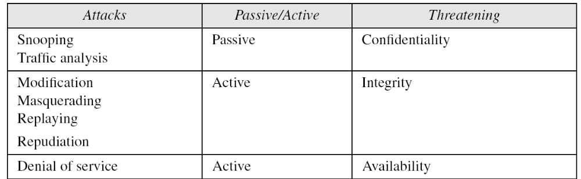
Categorization of passive and active attacks
B C Dhara, Dept. of IT, JU

Slide 28
Security Services and Mechanisms
ITU-T provides some security services and some mechanisms to implement those services.
  Security services and mechanisms are closely related because a mechanism or combination of mechanisms are used to provide a service and a mechanism may be used in different services
B C Dhara, Dept. of IT, JU

Slide 29
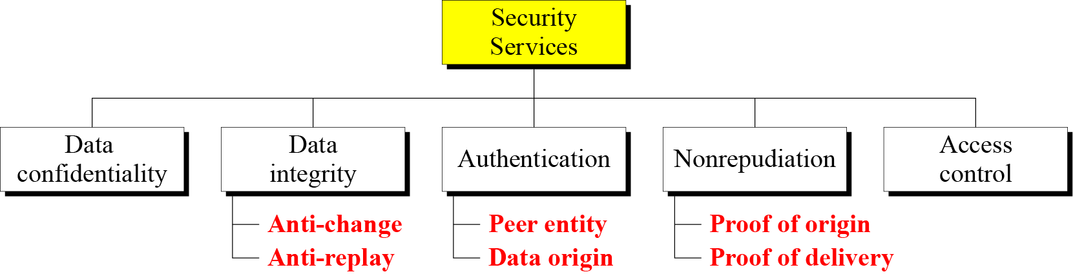
Security Services
ITU-T (X.800) has defined five services related to the security goals and attacks
B C Dhara, Dept. of IT, JU

Slide 30
Security services (Contd…)
Data confidentiality is designed to prevent snooping and traffic analysis attack
Data integrity is designed to protect data from modification, insertion, deletion, and replaying by an adversary
Authentication includes the authentication of the party at the other end of the line (in case of connection oriented communication) and authenticates the source of data (in connectionless communication)
B C Dhara, Dept. of IT, JU

Slide 31
Security services (Contd…)
Nonrepudiation service protects any repudiation by either sender or receiver
  With proof of origin, the receiver can later prove the identity of the sender if denied
  With proof of delivery, the sender can later prove that data were delivered to the intended recipient
Access control protects data against unauthorized access
  Access may involve reading, writing, modifying, executing program, etc.
B C Dhara, Dept. of IT, JU

Slide 32
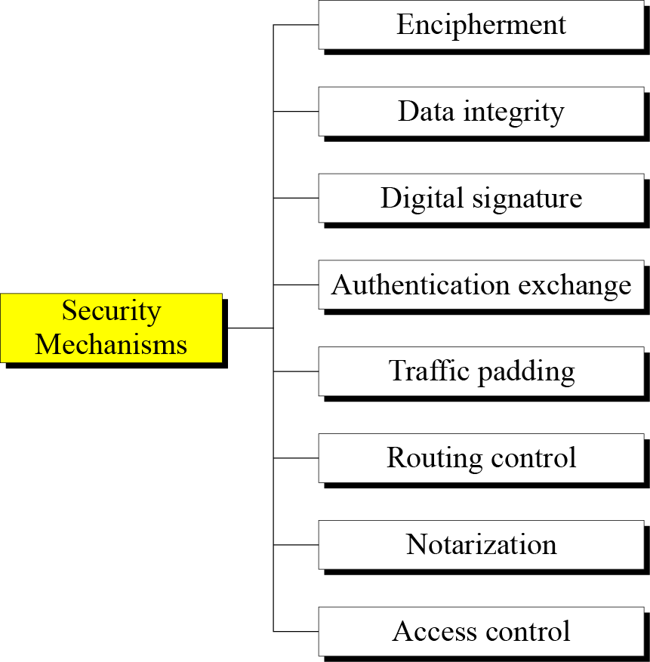
Security mechanisms
ITU-T recommends some security mechanisms to provide the security services
B C Dhara, Dept. of IT, JU

Slide 33
Security mechanisms (contd…)
Encipherment mechanism includes two techniques cryptography and steganography to provide confidentiality
Data integrity mechanism appends check value (computed by certain process) to the data
  Receiver received data and check value and recomputed new check value and compare with old one
B C Dhara, Dept. of IT, JU

Slide 34
Security mechanisms (contd…)
Digital signature is a means by which the sender can electronically sign the data and the receiver can electronically verify the signature
  Using private key, public key pair
Authentication exchange established the identity of the sender and receiver through exchanging some messages
B C Dhara, Dept. of IT, JU

Slide 35
Security mechanisms (contd…)
Traffic padding inserts some bogus data into the data traffic to resists the adversary’s attempt to use the traffic analysis
Routing control changes different available routes between the sender and receiver continuously to prevent the eavesdropping on a particular route
B C Dhara, Dept. of IT, JU

Slide 36
Security mechanisms (contd…)
Notarization means selecting a third party to control the communication between two parties
  Prevent repudiation
Access control establish that a user has access right to the data or resources owned by the system
  Use of password and PIN
B C Dhara, Dept. of IT, JU

Slide 37
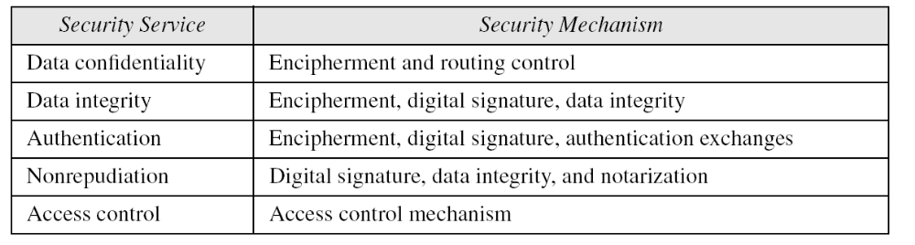
Relation between Services and Mechanisms
B C Dhara, Dept. of IT, JU

Slide 38
TECHNIQUES
Mechanisms discussed in the previous sections are only theoretical recipes to implement security. The actual implementation of security goals needs some techniques
Two techniques are prevalent today: cryptography and steganography.
B C Dhara, Dept. of IT, JU

Slide 39
Cryptography
Cryptography, a word with Greek origins, means secret writing
Cryptography refer to the science and art of transforming messages to make them secure and immune to attacks
Cryptography referred to encryption and decryption of messages using secret keys
  Symmetric-key cryptography
  Asymmetric-key cryptography
  hashing
B C Dhara, Dept. of IT, JU

Slide 40
Steganography
The word steganography, with origin in Greek, means covered writing
B C Dhara, Dept. of IT, JU

Slide 41
Thank You
?
B C Dhara, Dept. of IT, JU

